Slide 1
Cloud Watch
Theoretical Portion

Slide 2
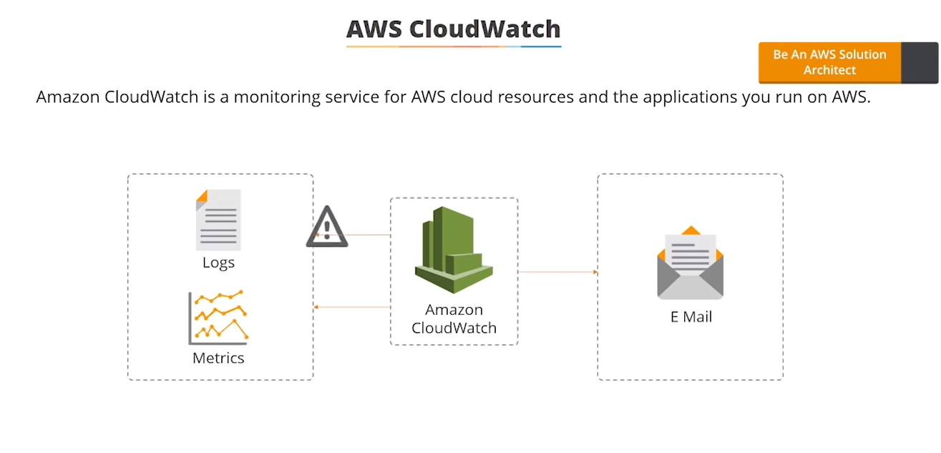
1.Cloud watch depending on multiple metrics and participating in the triggering the alarm. 2.Cloud Watch also monitors the AWS Environment Services.

Slide 3
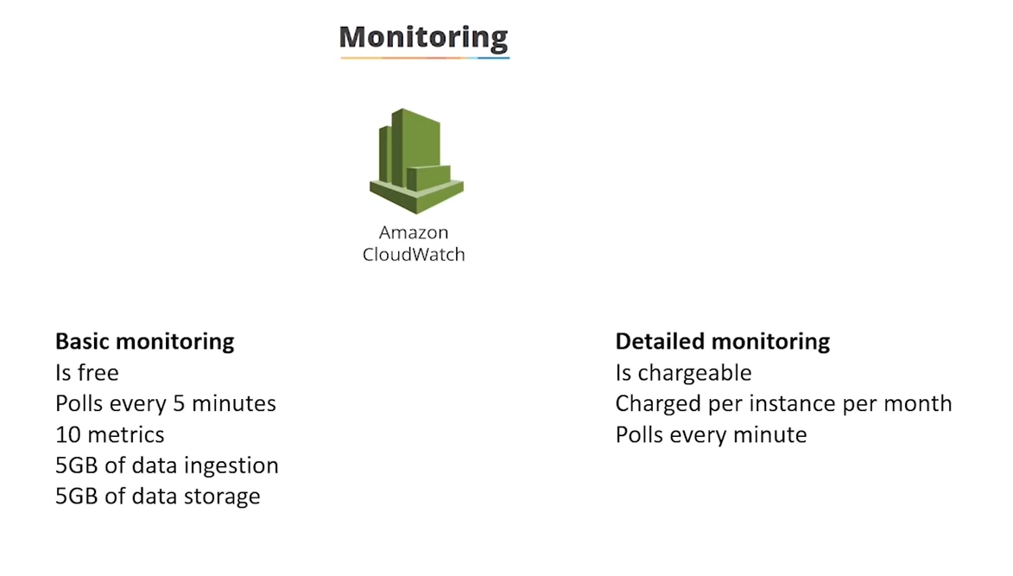

Slide 4
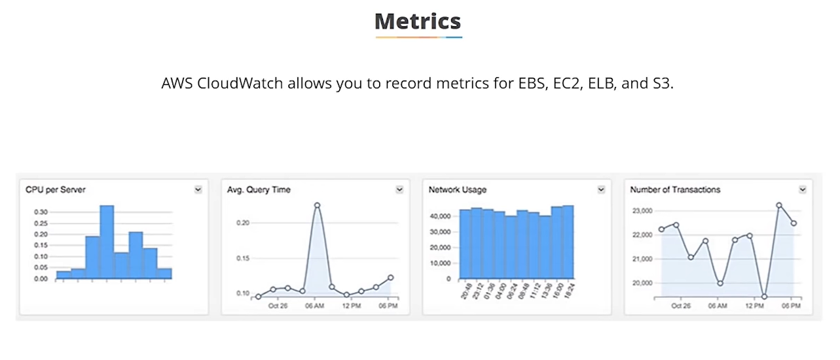

Slide 5
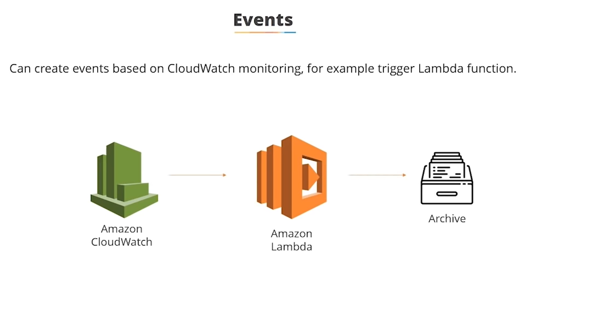

Slide 6
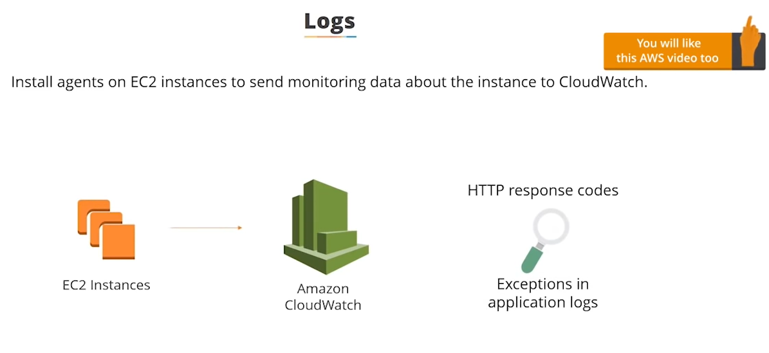

Slide 7
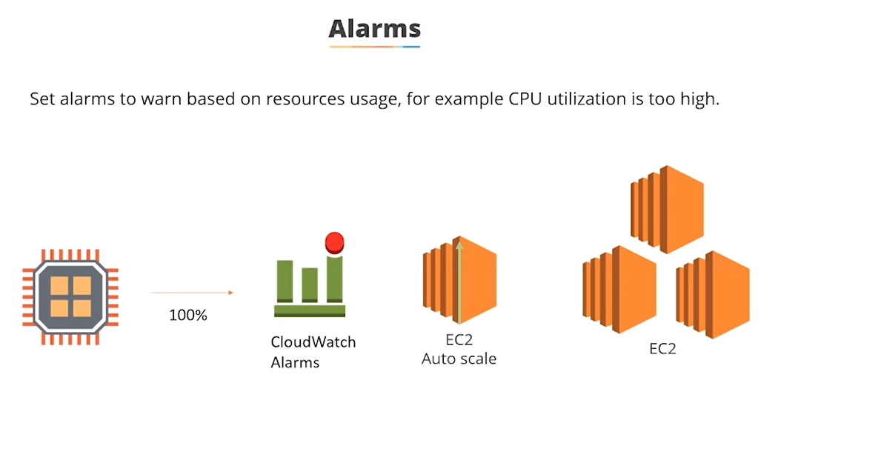

Slide 8
